Slide 1
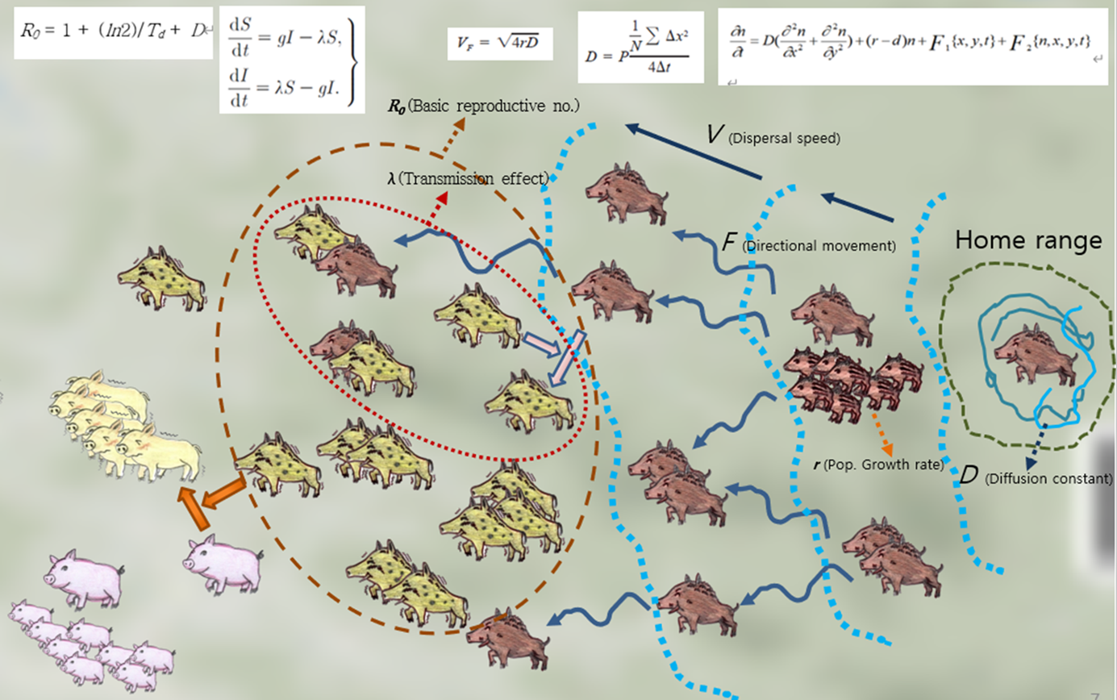
Individual based model for wild boar dispersal and disease transmission enhanced with active and passive movements

Slide 2
I. Backgrounds and Objectives
ASF rapidly expanding internationally as well as in Korea since ca. 2000
Difficult to analyze and predict due to complexity of epizootics and experiments
Mechanism based models are developed to make objective prognosis of host population dispersal and disease transmission

Slide 3


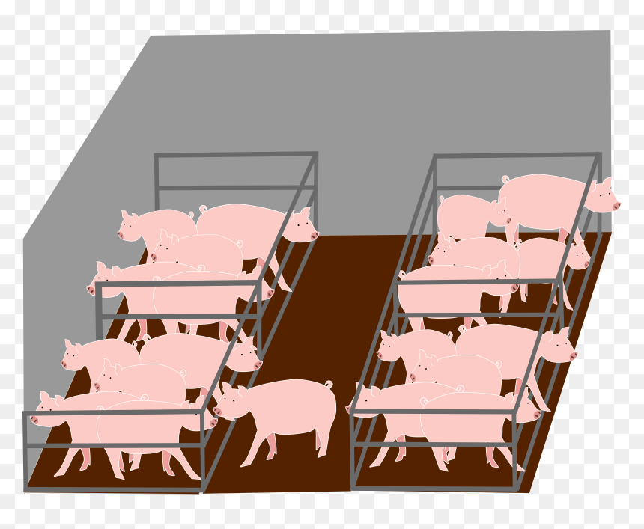
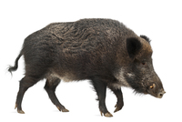
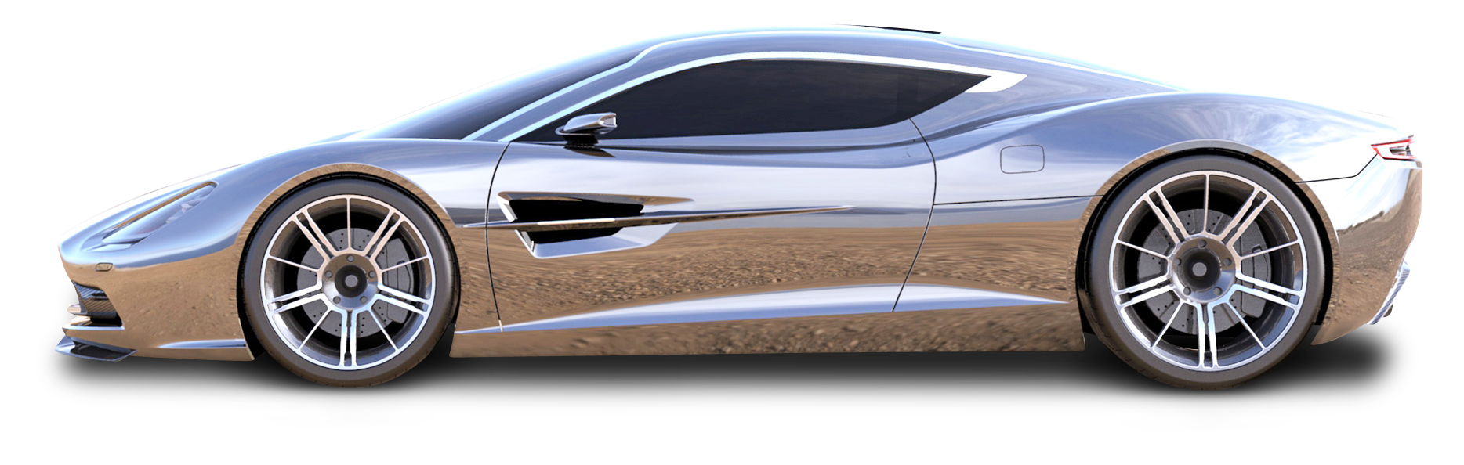
Content
Population density
Introduction
Materials and Methods
Results
Discussion and Conclusion
I
Boar
δ
A
d
Farm
c
a
b
C
II
B
Traffic density
D
Traffic, transport and human population effects

Slide 4



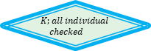


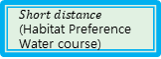


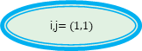
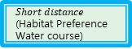





IBM Flow chart including movement and reproduction
Reproduction?
Y
HMM: parameter esti. (time, capture pressure)
N
HMM: event gen
$$t=0$$
Generate prog.〖 𝐵〗_𝑘 (𝑖,𝑡)
Det. Lin. dist.
Carrying capacity
Fem. Beha. state
ML: Habitat suit
Input: env. Data
(time, capture pressure)
0
1
Feeding
Det. rot. dir.
$Short distance$ (Habitat Preference
Water course)
i,j$=(1,1)$
Allee effect
HMM: event gen
$$B_{k}(i,t)$$
Y
Population
Growth
HMM: parameter esti. (time, capture pressure)
1
Det. Lin. dist.
$$Female?$$
0
Male Beha. state
N
ML: Habitat suit
Feeding
$Short distance$ (Habitat Preference
Water course)
Det. rot. dir
$$H_{l}(i,t)$$
N
$$K;all individual$$
$$checked$$
k$+=1$
N
Y
L$+=1$
L$;all hunters$
$$checked$$
Y
$$i,j+=1$$
N
N
$$t=t_{end}?$$
$$t+=1$$
I,j$;all cells$
$$checked??$$
$$end$$
Y
Y

Slide 5
Materials and methods :
IBM Linked with HMM in presenting wild boar movement and ASF transmission
Input (Data B): Movement
Input (Data B): Prob. of long Dist.
Input (Data C): Spatial covariates
HMM Parameters
Habitat suitability
State deter (TPM)
Long
Movement
Determine
Distance
Determine
position
Remove
Y
Long Movement?
Determine habitat (EPM)
N
Short movement
Land to new position
Natural death?
N
Hunter kill ?
Y
Move to nearest forest and lay in ground (100% mortality rate)
ASF transmission (0.3)
Traffic and vector transmission (from equation)
N
ASF?
Y
(Remove)

Slide 6
The process of HMM training and generating movement sequences.
Materials and methods :
Training process
Individual movement coordinates (Bukhan san mountain observation data)
Movement according to event sequences
Input: covariates (Forest, Food, Water)
Construct event sequences
Seq 2
E1 | E2 | E1 | E3 | E4 | E3 | E7 | E8 | E1
E2 | E1 (random E1) | E1 | E2 | E2 | E2 | E7 | E4 | E8
E1 | E2 | E2 | E3 | E1 | E3 | E3 | E8 | E1
E2 | E1 | E1 | E2 | E4 | E2 | E7 | E4 | E8 (randE8)
E1 | E2 | E4 | E3 | E3 | E3 | E2 | E7 | E1
E2 | E7 | E1 | E2 | E4 | E2 | E7 | E4 | E8
E1 | E2 | E3 | E3 | E2 | E3 | E1 | E8 | E1
E2 | E1 | E2 | E2 | E1 | E2 | E7 | E4 | E8
E1 | E2 | E7 | E3 | E4 | E3 | E4 | E8 | E1
E2 | E1 | E1 | E2 | E3 | E2 | E7 | E4 | E8
E1 | E2(rand E2) | E8 | E3 | E4 | E3 | E2 | E8 | E1
E2 | E1 | E1 | E2 | E4 | E2 | E7 | E4 | E8
E1 | E2 | E1 | E3 | E2 | E3 | E7 | E8 | E1
E2 | E1 | E2 | E2 | E1 | E2 | E3 | E4 | E8
E1 | E2 | E1 | E3 | E4 | E3 | E7 | E8 | E1
E2 | E1 | E4 | E2 | E3 | E2 | E2 | E4 | E8
Individual 1 Seq 1
Seq 1
E1
E8
E1
E8
E1
E8
E1
Define No. of states ( e.g., 3)
Train with random initial TPMs and EPMs
Estimated TPM & EPM
Generate sequences (Seq1, Seq2 …) from TPM and EPM and individual move*
Individual 2 Seq 2
E1
E2
E2
E1
E7
E8
E2
Event table
* When individual is younger than 2 months, it moves with parent, otherwise moves separately.
 | Forest | Forest | No-forest
 | Broad and mixed-leaf | Needle-leaf | No-forest
Water | E1 | E3 | E5
No-water | E2 | E4 | E6
Habitat map with events E

Slide 7
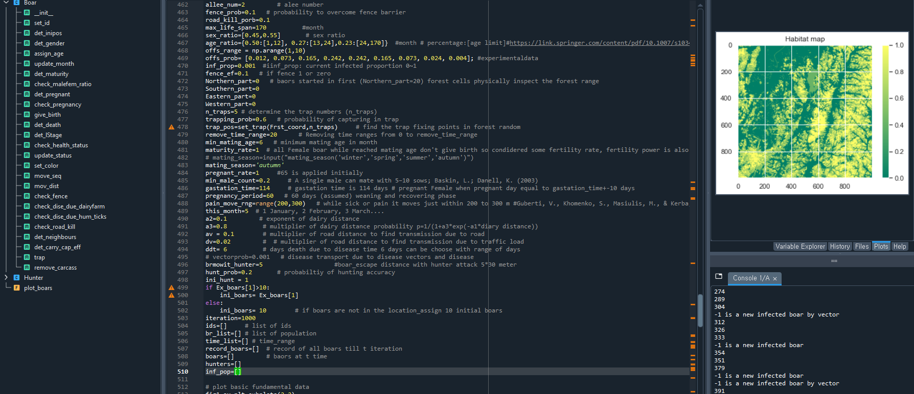
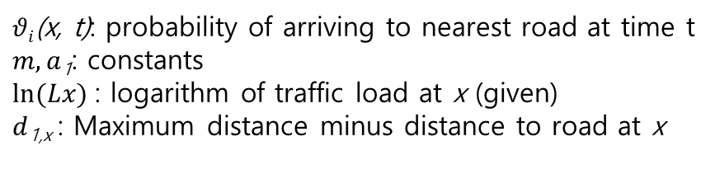
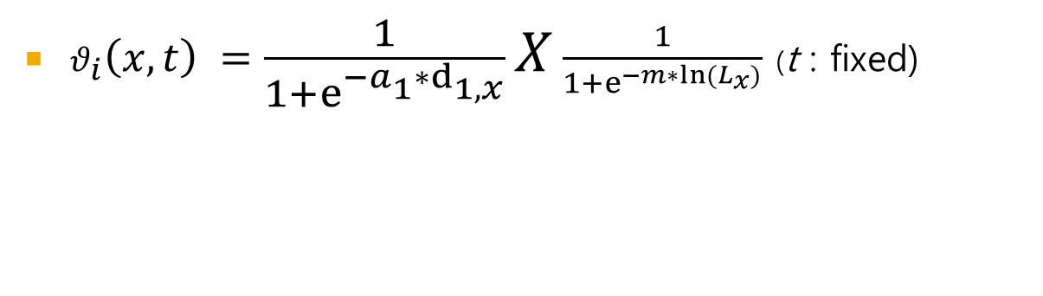
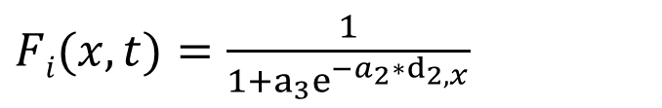
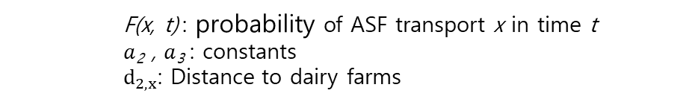
Material and Methods Traffic effect according to distance to road and traffic load
$θ_{i}\left(x,t\right) =\frac{1}{1+e^{−a_{1}∗d_{1,x}}}X\frac{1}{1+e^{−m∗{ln⁡(L}_{x})}}$ (t : fixed)
$θi$(x, t): probability of arriving to nearest road at time t
$m, a$₁: constants
$ln⁡(Lx)$ : logarithm of traffic load at x (given)
$d$_{1,x} : Maximum distance minus distance to road at x
$Fi(x,t)=\frac{1}{1+a_{3}e^{−a_{2}∗d_{2,x}}}$
F(x, t) : probability of ASF transport x in time t
$a$₂ , $a$₃ : constants
$d_{2,x}$: Distance to dairy farms
Functions and parameters window

Slide 8
Material and Methods: Passing through Fence
ID₁
x₁₁,y₁₁
Fence
Moved distance ☑
x₁₂,y₁₂
Moved distance (update)
x₂₂,y_{curve}
Moved distance (sim.)
X₁,y_{curve}
x₂₁,y_{curve}
x₁₂,y_{curve}
_{Passing hole}
X_{12’},y_{12’}
x₂₂,y₂₂
Moved distance ☑
ID₂
x₂₁,y₂₁
Fence design

Slide 9
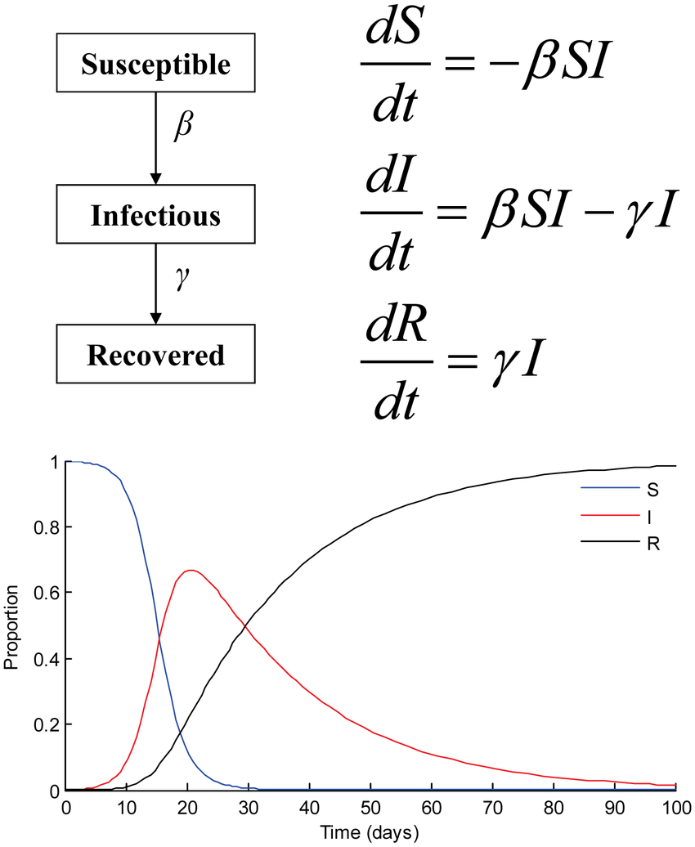
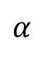
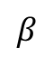
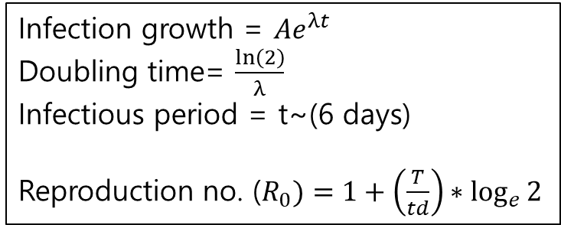
Materials and methods : ASFV transmission (SIR)
Growth rate ($α)$=f(offspring, natural mortality)
$$α$$
Infection growth = $Ae^{λt}$
Doubling time= $\frac{\ln\left(2\right)}{λ}$
Infectious period = t~(6 days)
Reproduction no. ($R_{0})=1+\left(\frac{T}{td}\right)∗\log_{e}{2}$
$$β$$
γ
Reproduction no (R0) calculation (Doubling time and infectious time method)
$α$: Growth rate; β: Infection rate; γ: death rate

Slide 10
Material and Methods Model parameters
SN | Description | Model notation |  | Unit
1 | Cell size | grid_size | 30 | m
2 | long movement prob | longporb | 0.2
3 | long sort dist. Movement range | LS_dis | [[500 1800],[0,466]]
4 | Transition probability matrix | TPM | ([[0.8,0.2],[0.3,0.7]])
5 | Emission probability matrix | EPM | [[0.683,0.044,0.119,0.064, 0.001,0.089],[0.007, 0.795, 0.007, 0.006, 0.109, 0.076]])
6 | Neighbour range | neighbour_dist | 20
7 | Carrying capacity | carrying_cap | 600
8 | Overpopulation holding days | carry_bear_day | 50
9 | Allee number | allee_num | 2
10 | Fencing penetration probability | fence_prob | 0.1
11 | Road Kill porbacity | road_kill_porb | 0.1
12 | Maximum life span | max_life_span | 170 | month
13 | Sex ratio | sex_ratio | [0.45,0.55]
14 | Age ratio | age_ratio | {0.50:[1,12], 0.27:[13,24],0.23:[24,170]}
15 | Offspring range | offs_range | np.arange(1,10)
16 | Offspring probability | offs_prob | [0.012, 0.073, 0.165, 0.242, 0.242, 0.165, 0.073, 0.024, 0.004]
17 | Infection probability | inf_prop | 0.001
18 | Fencing efficiency | fence_ef | 0.1
19 | Allocate in north part | Northern_part | 1 | 0 or 1
20 | Allocate in southern part | Southern_part | 0 | 0 or 1
21 | Allocate in eastern part | Eastern_part | 0 | 0 or 1
22 | Allocate in western part | Western_part | 0 | 0 or 1
SN | Description | Model notation |  | Unit
23 | Number of traps | n_traps | 5
24 | Trapping probability | trapping_prob | 0.6
25 | Trap position | trap_pos | Frst_coord
26 | Infected boar removal range | remove_time_range | 20
27 | Minimum mating age | min_mating_age | 6
28 | Maturaty for pregnant rate | maturity_rate | 1
30 | Mating season | mating_season | 'autumn'
31 | Pregnant rate | pregnant_rate | 1
32 | Minimum male ratio for mating | min_male_count | 0.2
33 | Gastation time | gastation_time | 114
34 | Pregnancy period | pregnancy_period | 60
35 | Infected boar movement range | pain_move_rng | range(200,300)
36 | Current month | this_month | 5
37 | Prob. for dist. factor constant 1 | a2 | 0.1
38 | Prob. for dist. factor constant 2 | a3 | 0.8
39 | Prob. for. vechile distance constant 3 | av | 0.1
40 | Multiplier of road distance probability | dv | 0.02
41 | Death date due to disease | ddt | 6
43 | Boar escape from hunter | brmowit_hunter | 5
44 | Hunting probability | hunt_prob | 0.2
45 | No of hunters | ini_hunt | 1
46 | No of initial boars | ini_boars | 586
47 | Iteration | itrn | 2000
48 | Replication | repn | 1

Slide 11
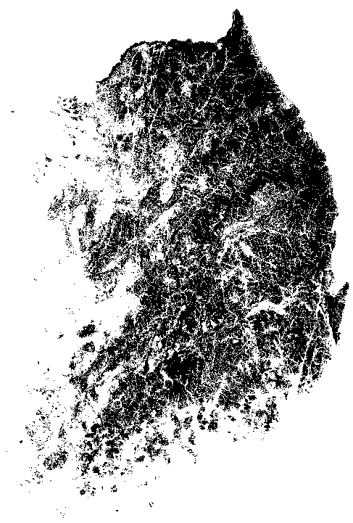
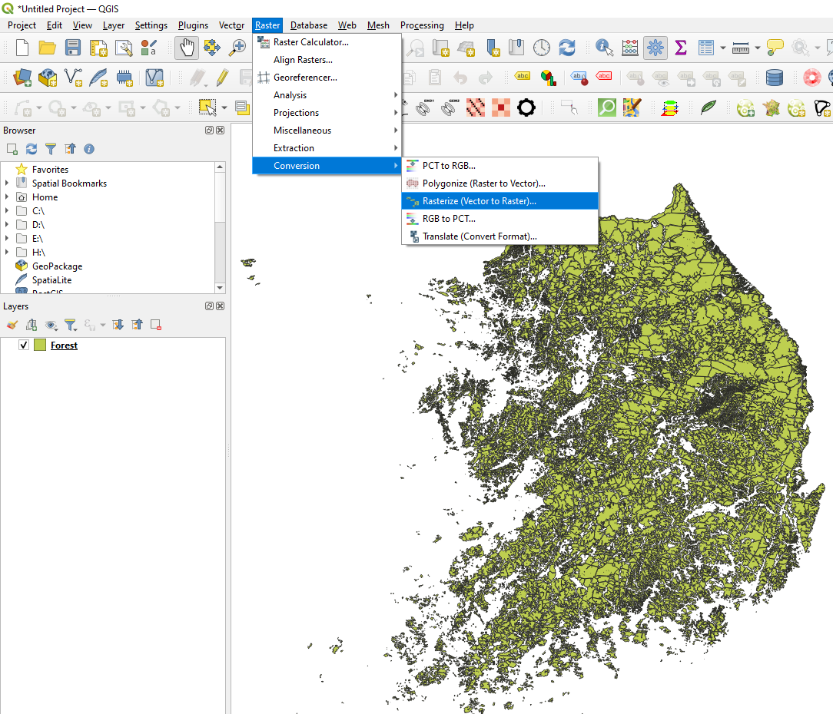
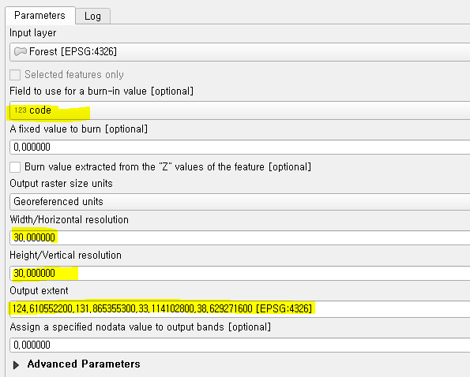
Environment data processing
Use geo processing tool (e.g., ArcGIS, QGIS and GeoPandas)
Create raster data with required cell size (e.g., 30m x 30m, N x M ) with raster creating tools with identical dimensions (extent, cell size, coordinate reference system(CRS))
Save raster file in .tif format
An example in QGIS as below:
Input .shp (vector data)
Developing raster data with required cell (grid) size and extent with burn-in value
Output Forest.tif

Slide 12
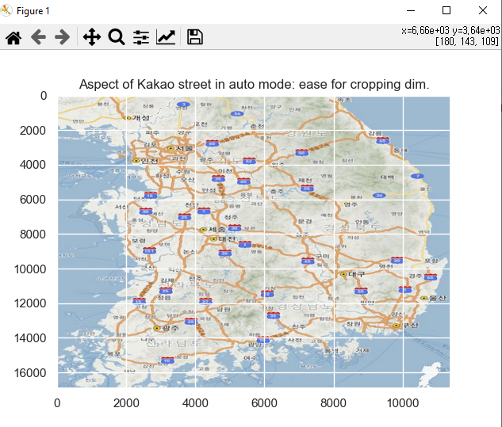
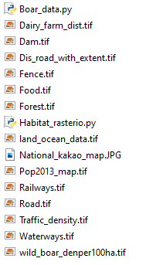
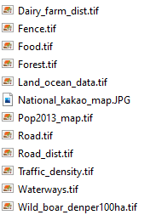


Base files to run the program
Main run file
Habitat setup file
Distance to dairy geo data
Fence geo data
Food geo data
Forest geo data
Land and ocean geo data to set boundary
National map to judge physical boundary
Human population density geo data
Road network geo data
Distance to road geo data
Vehicle traffic geo data
Waterway geo data
Existing wild boars per hector geo data
Study area location can be picked with matplotlib ‘auto’ mode

Slide 13
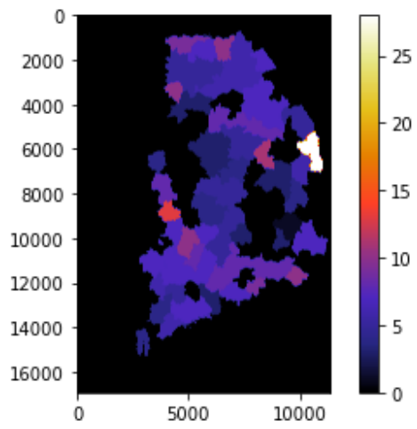
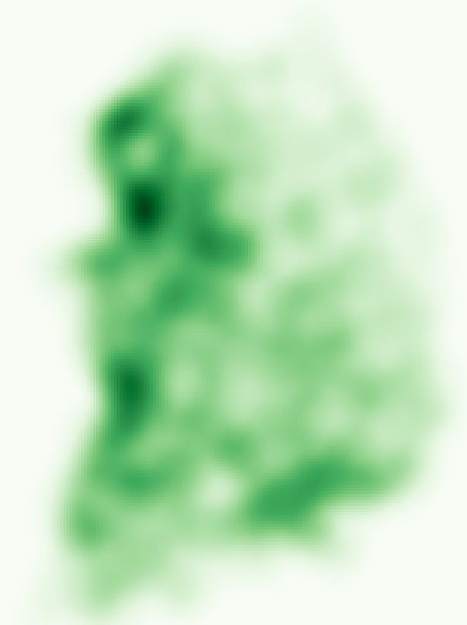
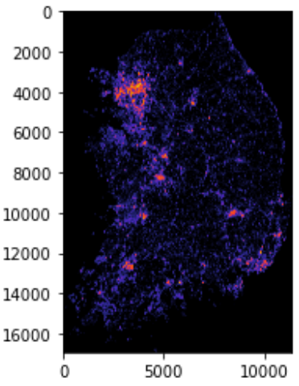
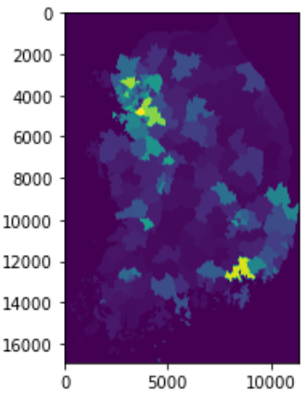
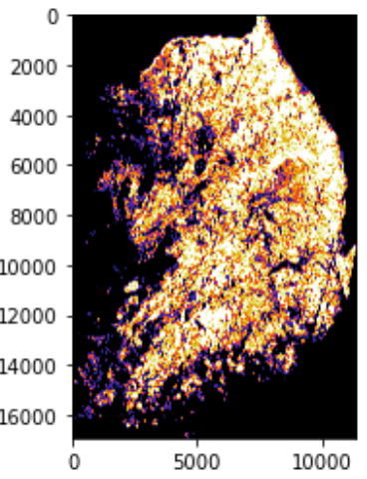
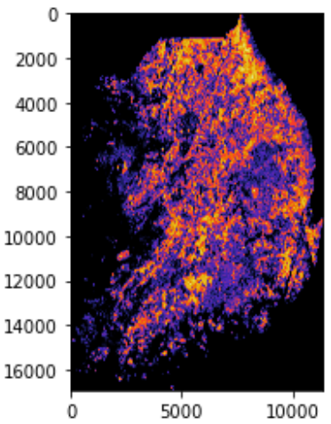
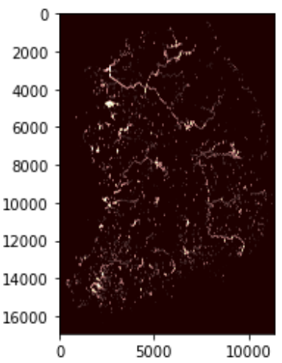
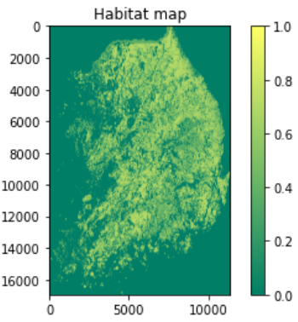
Material and Methods Environmental data
Wild boar density per 100ha (NIBR, 2019)
Traffic density
Road
Human Population
Food
(Mixed and Broadleaves)
Water
Event_map (Habitat map)
Forest

Slide 14
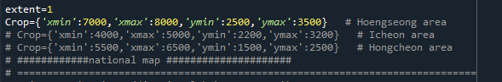
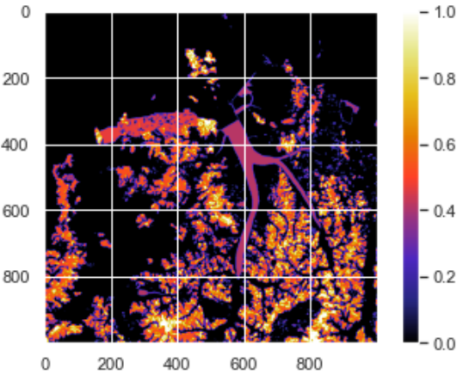
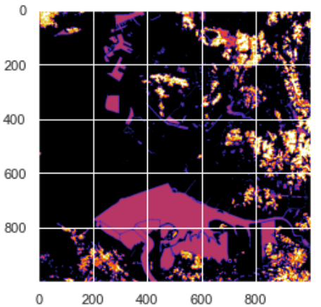
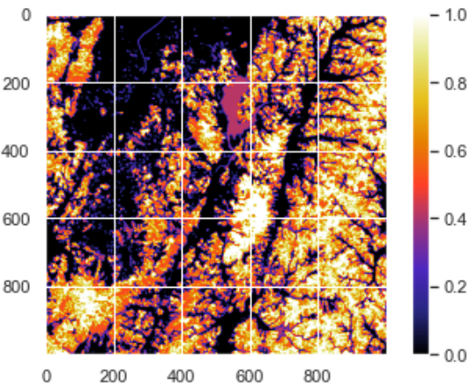
Material and Methods Observation on specific region
Hwacheon, Icheon and Hoengseong area 30m x 30m grid with 30 x30 KM² space (Habit event Map)
Hoengseong
Hongcheon (흥천) area
Icheon (이천)
Hoengseong (횡성)
14

Slide 15
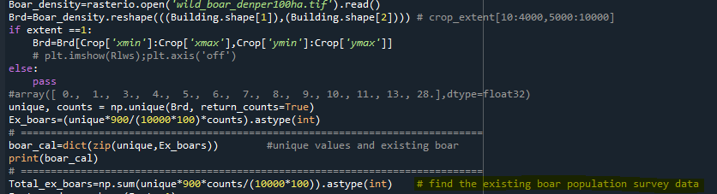
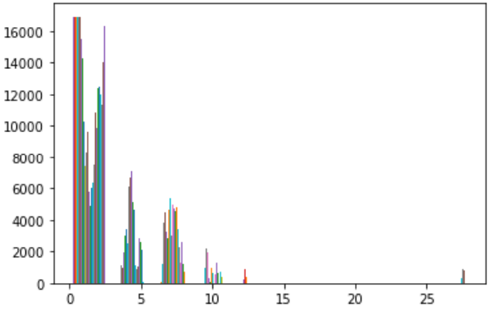
Material and Methods Existing wild boars based on report NIBR 2019
Density per 100 hector | Cells(900m²) | Existing Boars
1.1 | 1017901 | 1007.722
3 | 7640942 | 20630.54
4 | 5541112 | 19948
5 | 10913674 | 49111.53
6 | 5969495 | 32235.27
7 | 13710750 | 86377.73
8 | 7222236 | 52000.1
9 | 1385521 | 11222.72
10 | 2648720 | 23838.48
11 | 747932 | 7404.527
13 | 615446 | 7200.718
28 | 1102842 | 27791.62
Total boars in Korea | Total boars in Korea | 338,769
Hongcheon (흥천) : #758
Hoengseong (횡성): #586
Icheon (이천): #78
Density per 100 ha
Ex. Boar density in 30 x 30 sqKm
Total wild boar with for density data = 338,769

Slide 16
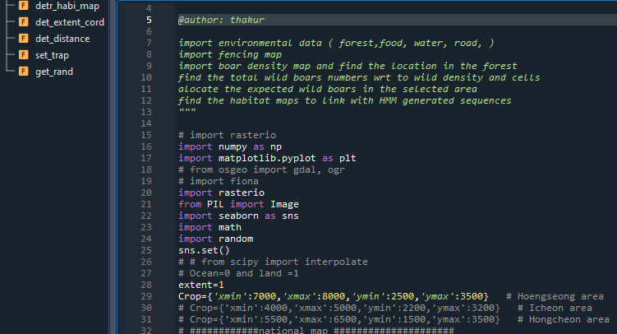
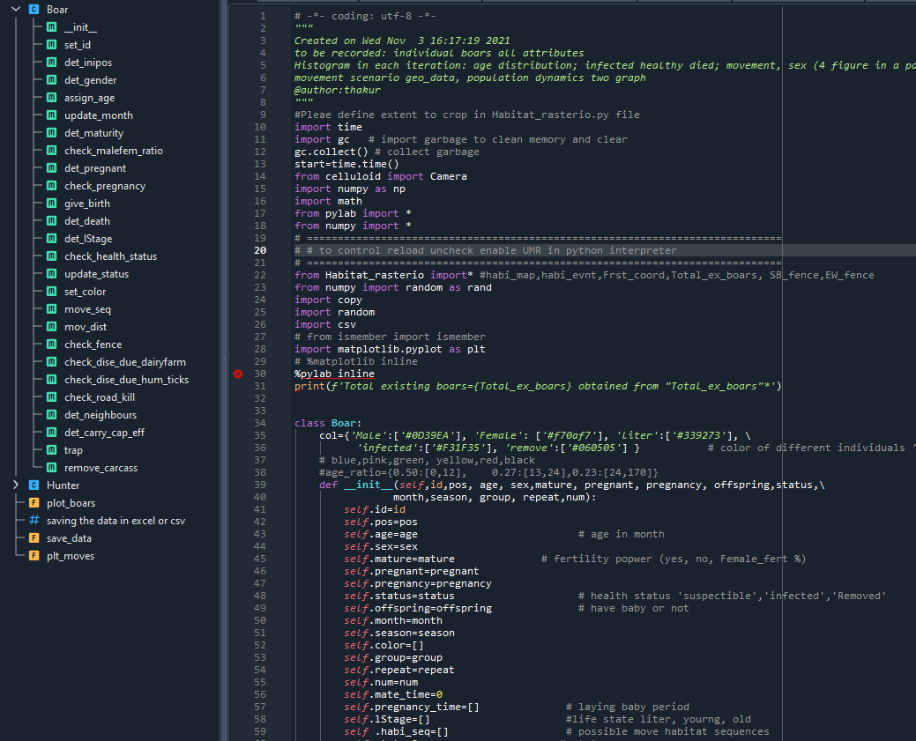
Material and Methods : Major functions
Habitat environment setup
Boar individual dynamics

Slide 17

Material and Methods : Imported libraries and modeling environment
language | version
Python | 3.8.12
IDE
Spyder | 5.12.3
Library
numpy | 1.21.4
matplotlib | 3.4.3
pandas | 1.3.4
rasterio | 1.2.10
math
random
celluloid
copy
csv
Libraries

Slide 18
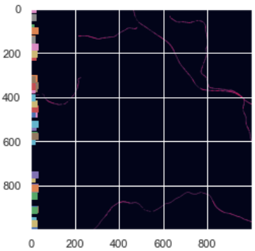
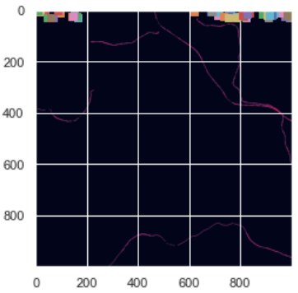
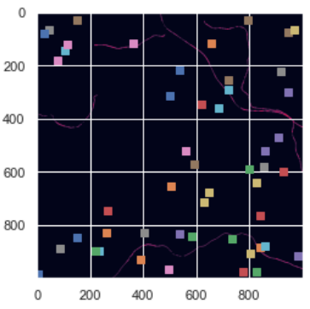
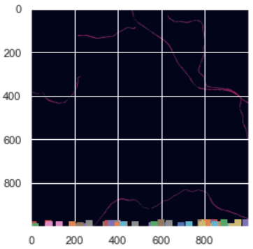
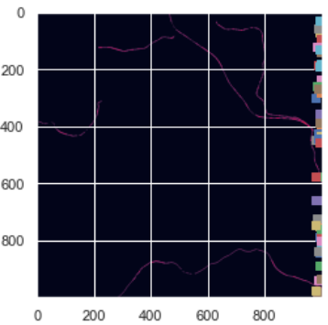
Initial boar position in different direction
West
North
Random spread
South
East

Slide 19
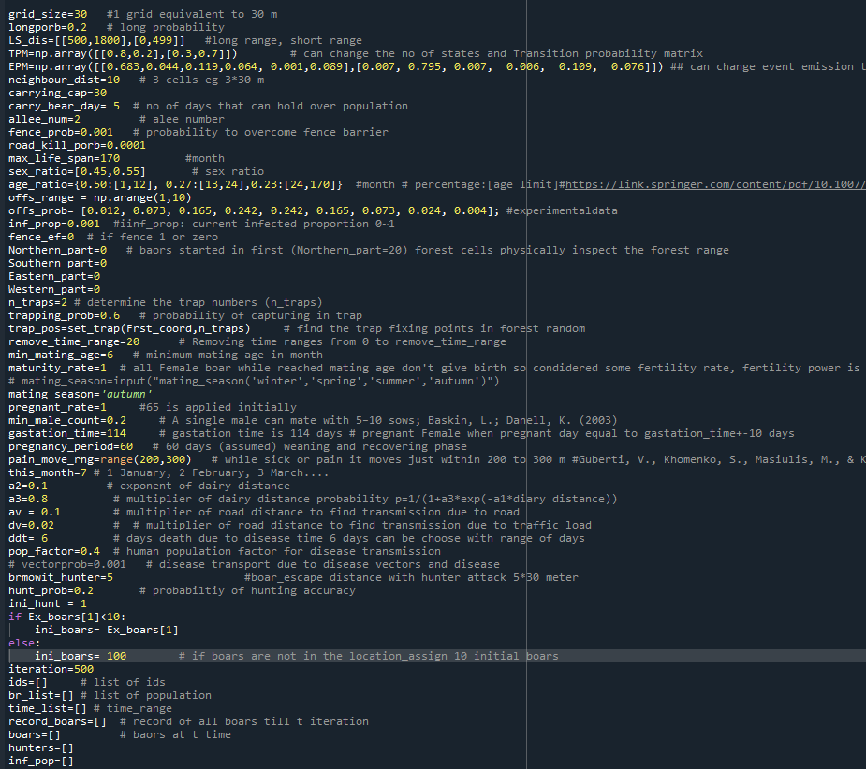
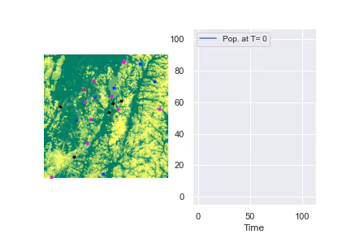
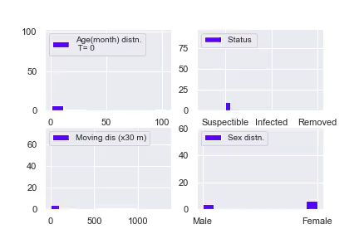
Experiment and analysis
Initial input simulation parameters and example of simulated video
Movement visualization
Pop. growth visualization
Age, health status, movement average movement and sex visualization in each iteration

Slide 20
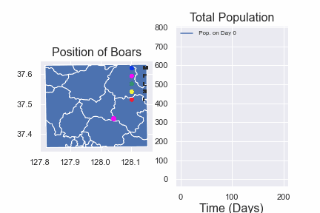
Experiment and analysis
Population growth without disease
(carrying capacity 3 on R900 m, initial pop:10)
1/20/2022
EnFRA
20

Slide 21
Experiment and analysis Movement of individuals per day
S.N | Mean (Cell unit) | Std (cell unit)
1 | 3.37 | 2.03
2 | 3.031 | 2.13
3 | 3.24 | 2.29
4 | 2.99 | 2.19
5 | 3.17 | 2.32
6 | 3.36 | 2.25
7 | 3.27 | 2.29
8 | 3.57 | 2.3
9 | 3.15 | 2.26
10 | 2.93 | 2.20
Average | 3.21 | 2.23
97 ± 67 m/day from 10 observations (Movement with HMM defined behavior)
*(Mean, Sd) =(3.21,2.23) *30 m =(96.24 ± 66.78)

Slide 22
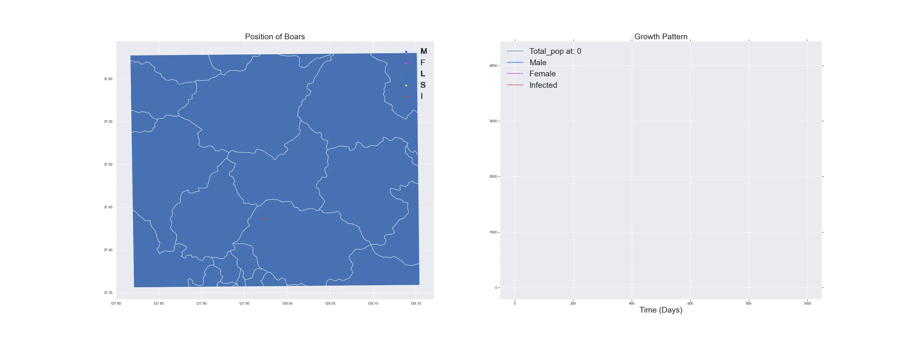
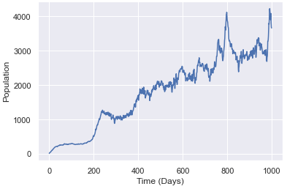
Experiment and analysis Population growth at 1% transmission (carrying capacity 5 on R900 m, initial pop:10,initial infection 1)

Slide 23



Experiment and analysis Population growth at 40% transmission (carrying capacity 5 on R900 m, initial pop:10,initial infection 1)
Population status
Population growth simulation
Death population rate

Slide 24



Experiment and analysis Population growth for 50 replication, {initial pop:10, carrying cap:5, initial infection rate:0.1, transmission rate:0.03, carcass removal day:6, Simulation time 200 days}
Population growth
A simulation case among 50 replication
Infection initially slow then spread with increasing population
Infection growth

Slide 25


Experiment and analysis Population dynamics considering existing boars (586) (carrying cap:30, neighbour_radius:3Km, disease rate:0.03,
Spatial distribution and population dynamics
Population dynamics frequency plot

Slide 26



Experiment and analysis Population dynamics considering initial boars (10), simulation start at autumn (mating) season (carrying cap:30, neighbour_radius:3Km, disease rate:0.03,
Trap
Death
Male
Female

Slide 27

Experiment and analysis : State (2 state) change in the course of movement
State
Time

Slide 28

Experiment and analysis: Output in .csv format of after simulation

Slide 29
Experiment and analysis: ASF studies and reproduction number (R0)
Host | Place | Method | R0 | Infectious period(days) | Doubling time | Source
Wild boar | Czech Republic | Doubliing time | 1.95 | 6 | 4.39 | Marcon et.al.,(2019)
Wild boar | Belgium |  | 1.65 | 6 | 6.43 | Marcon et.al.,(2019)
Pig herds | Uganda | Nearest neighbnour | 3.24 |  | - | Barongo et.al(2015)
 |  | Doubliing time | 1.63 | 30 | 1.106 | Barongo et.al(2015)
 |  | SI-based(curve fitting,linear regression,SI/N proportion) | (1.58,1.90, 1.77) | - | - | Barongo et.al(2015)
Pigs | Netherlands | Survival analysis (contact tranmission experimetn) | 0.3 | - | - | Eblé et.al.,(2019)
Pig herds | Vietnam | SIR | 10 | - | - | Bui et.al., (2020)
pig-to-pig | Georgia | SEIR(transmission experiment) (with in pen) | 2.8 | - | - | Guinat et.al.,(2015)
pig-to-pig | Georgia | SEIR(transmission experiment) (between in pen) | 1.4 | - | - | Guinat et.al.,(2015)
Wild Boars | Russian | Doubliing time(space–time clusters) | 1.58 | 6 |  | Iglesias et.al.,(2014)
Domestc pig(between farms) |  | SEIR | 2~3 | 5 |  | Gulenkin et.al.,(2011)
Domestc pig(within infected farm) |  | SEIR | 8 ~11 | 15 |  | Gulenkin et.al.,(2011)
Domestic pig(within farm) | Ukrain | Doubling time | 1.65 | 7 |  | Korennoy et.al.,(2016)
Domestic pig(between farms) | Ukrain | Doubling time | 7.46 | 19 |  | Korennoy et.al.,(2016)
Pig within farm | Malta’78 | Doubling time | 18 | 6.8 |  | De Carvalho Ferreira et al.,(2013)
 | Netherlands’86 | Doubling time | 4.92 | 4.6 |  | De Carvalho Ferreira et al.,(2013)
 | Armenia | Doubling time | 6.1 | 2~9 |  | Pietschmann et al., (2015)
Wild Boar | Italy | Doubling Time | 1.124 | 39 |  | Loi et.al.,(2020)
 |  | Force of Infection (λ) | 1.165 | - |  | Loi et.al.,(2020)
 |  | Proportion of Infected | 1.17 | - |  | Loi et.al.,(2020)
 |  | SEIR | 1.139 | 5~7 |  | Loi et.al.,(2020)
Wild boar (Current study) | South Korea | Doubling time | 1.16 | 6 | 28 | Field observation (816 cases)
 |  | Carcass removal days 6 | 1.095 | 6 | 43.87 | Simulation (200 days)
 |  | 10 | 1.103 |  | 40.53 | Simulation
 |  | 15 | 1.119 |  | 34.83 | Simulation
 |  | 20 | 1.121 |  | 34.31
 |  | 25 | 1.133 |  | 31.36

Slide 30
Discussion and future task
More movement data required to have detailed hidden state information on individual-population relationships
Incorporating detailed behavior (e.g., grouping, seasonal effect)
Checking effects of external conditions in details with
Hunting pressure
Local and global boundary effect
Feeding and eating behavior
Policy design

Slide 31
Conclusion
Effective in addressing disease transmission based on existing wild boar population
The experimental extent can be cut and examined through this model
Passive spread of disease can be examined

